Slide 1
Data Analyst Interview
City of Edmonton (Assessment & Taxation)
Aviel Chow

Slide 2
Questions
What are the top residential neighborhoods that retain their value over time?
What factors could affect market value?

Slide 3
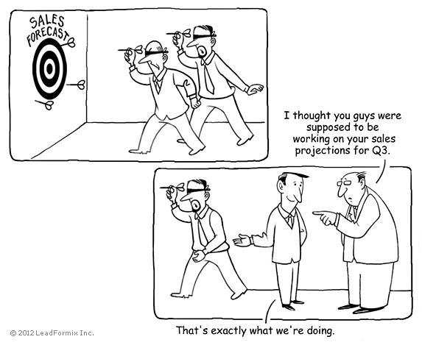
Top Residential Neighborhoods that Retain Value Over Time
Purpose: Forecasting Revenue

Slide 4
Steps
Data Cleaning
Exploration
Filtering the Data Set (Checking the Distribution)
Results

Slide 5

Data Cleaning – Assessment Data 2012-2018
Data Corrections for key neighborhoods with missing data
i.e. Terwilligar South renamed South Terwilligar in 2012

Slide 6
Data Exploration – Segmentation
I calculated the total market value of all properties within each neighborhood
I used the Sum of Year to Year % Change (not abs value) to determine stable communities
I checked the regression slope of the total assessed value vs. year as a sanity check

Slide 7
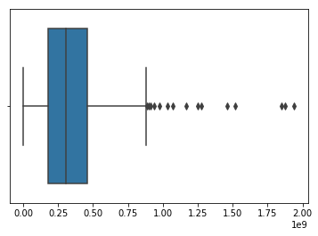
Data Filtering
Box Plot of Average of Total Assessed Values per Neighborhood From 2012-2018
High Value Neighborhoods tended to have higher % Change
Analyzed $150,000,000 to $600,000,000 and $600,000,000+
Used more than the Interquartile range because the higher revenue Neighborhoods are very important for forecasting

Slide 8
Top Ten Neighborhoods That Retain Value Over Time ($150,000,000 - $600,000,000)
 | Average Total Assessed Value | Sum of Year to Year % Change | Regression Slope
BRECKENRIDGE GREENS | 281,467,357 | -0.08% | 572,375
CALLINGWOOD NORTH | 175,186,429 | -0.01% | 702,821
RIDEAU PARK | 173,437,143 | 1.43% | 854,464
CENTRAL MCDOUGALL | 177,222,214 | -1.13% | 966,446
SUMMERLEA | 182,064,929 | 1.92% | 987,321
TIPASKAN | 214,731,643 | -0.01% | 1,008,768
BEAUMARIS | 529,940,786 | -0.23% | 1,094,554
BOYLE STREET | 246,541,786 | 0.37% | 1,251,500
HAIRSINE | 185,354,857 | 1.74% | 1,516,571
ORMSBY PLACE | 577,990,286 | 1.68% | 3,251,750

Slide 9
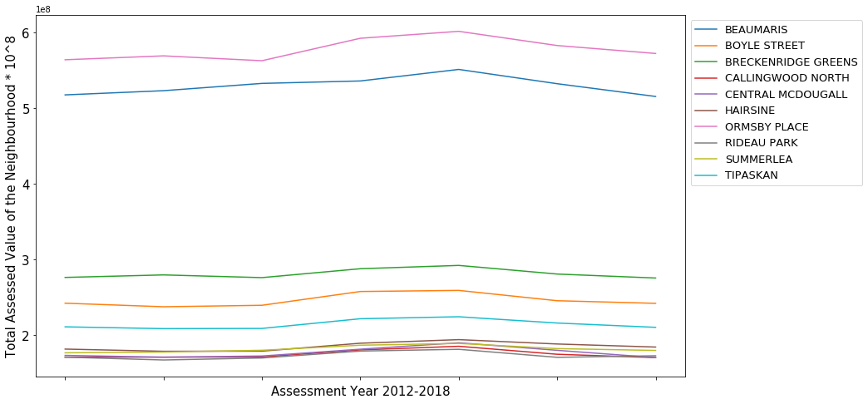
Top Ten Neighborhoods That Retain Value Over Time ($150,000,000 - $600,000,000)

Slide 10
Top Ten Neighborhoods That Retain Value Over Time ($600,000,000+)
 | Average Total Assessed Value | Sum of Year to Year % Change | Regression Slope
MACEWAN | 761,691,929 | 0.20% | 1,855,750
TERWILLEGAR TOWNE | 1,036,289,143 | 1.76% | 4,581,179
ELLERSLIE | 696,521,214 | 2.71% | 5,886,929
CUMBERLAND | 739,561,000 | 3.45% | 5,925,089
LYMBURN | 637,459,000 | 4.62% | 6,806,054
TWIN BROOKS | 1,164,520,857 | 2.69% | 6,849,304
BULYEA HEIGHTS | 686,435,643 | 5.71% | 7,663,964
KINISKI GARDENS | 760,354,714 | 4.88% | 8,771,000
GLASTONBURY | 881,787,929 | 5.92% | 10,810,143
SILVER BERRY | 899,998,143 | 5.52% | 11,169,911

Slide 11
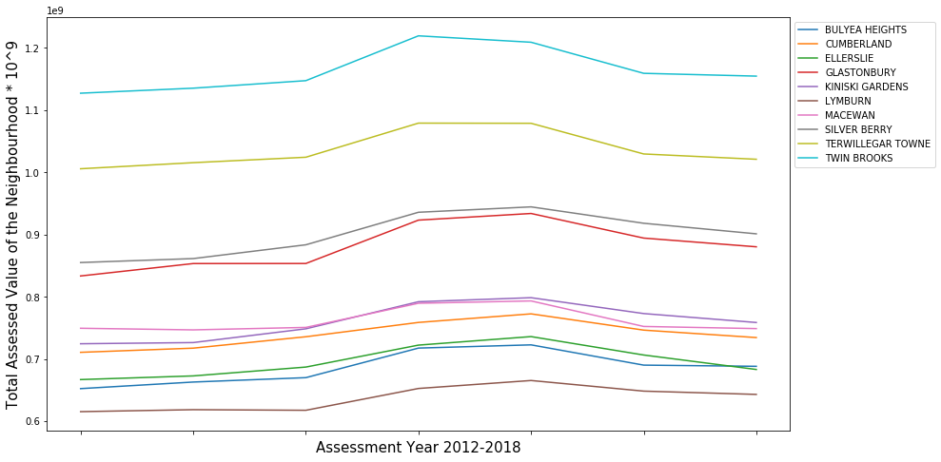
Top Ten Neighborhoods That Retain Value Over Time ($600,000,000+)

Slide 12
Improvements
Evaluate change in individual properties instead of change in the total assessed value in the neighborhood
Houses in neighborhood “A” could be decreasing but a temporary variable (development) could offset the decrease giving the illusion of a stable revenue stream

Slide 13
What Factor’s Affect Market Value

